Slide 1
Processor Performance in Image processing
Jeremy Noel | Melvin Houston | Jeffrey Tan | Akira Romyanond

Slide 2
TABLE OF CONTENTS
01
02
03
04
05
Jeffrey
PROJECT OVERVIEW
TOOLS & PLATFORMS UTILIZED
RESULTS
COMPARISON & ANALYSIS
CONCLUSION

Slide 3
Project Overview
Jeffrey
Proposition
Methodology
Execute a convolution/deconvolution algorithm on three different processors to benchmark their image processing capabilities.
Utilize MATLAB to convolute then deconvolute an image using standard convolution with an image and PSF (point spread function)
Feed the convoluted image through a Richardson Lucy deconvolution algorithm and analyze the results

Slide 4
Project Overview Cont.
Jeffrey
Controlled Variables and Benchmarked Items
All systems ran in safe mode to prevent seperate programs from interfering
All systems used the same code, image, and point spread function in MatLab
Administered separate tests with 1, 10, 50, and 100 iteration cycle(s)
Recorded performance of the system in task manager (for CPU Usage %)
Exported time elapsed for the process via MATLAB

Slide 5
02
TOOLS & PLATFORMS UTILIZED

Slide 6
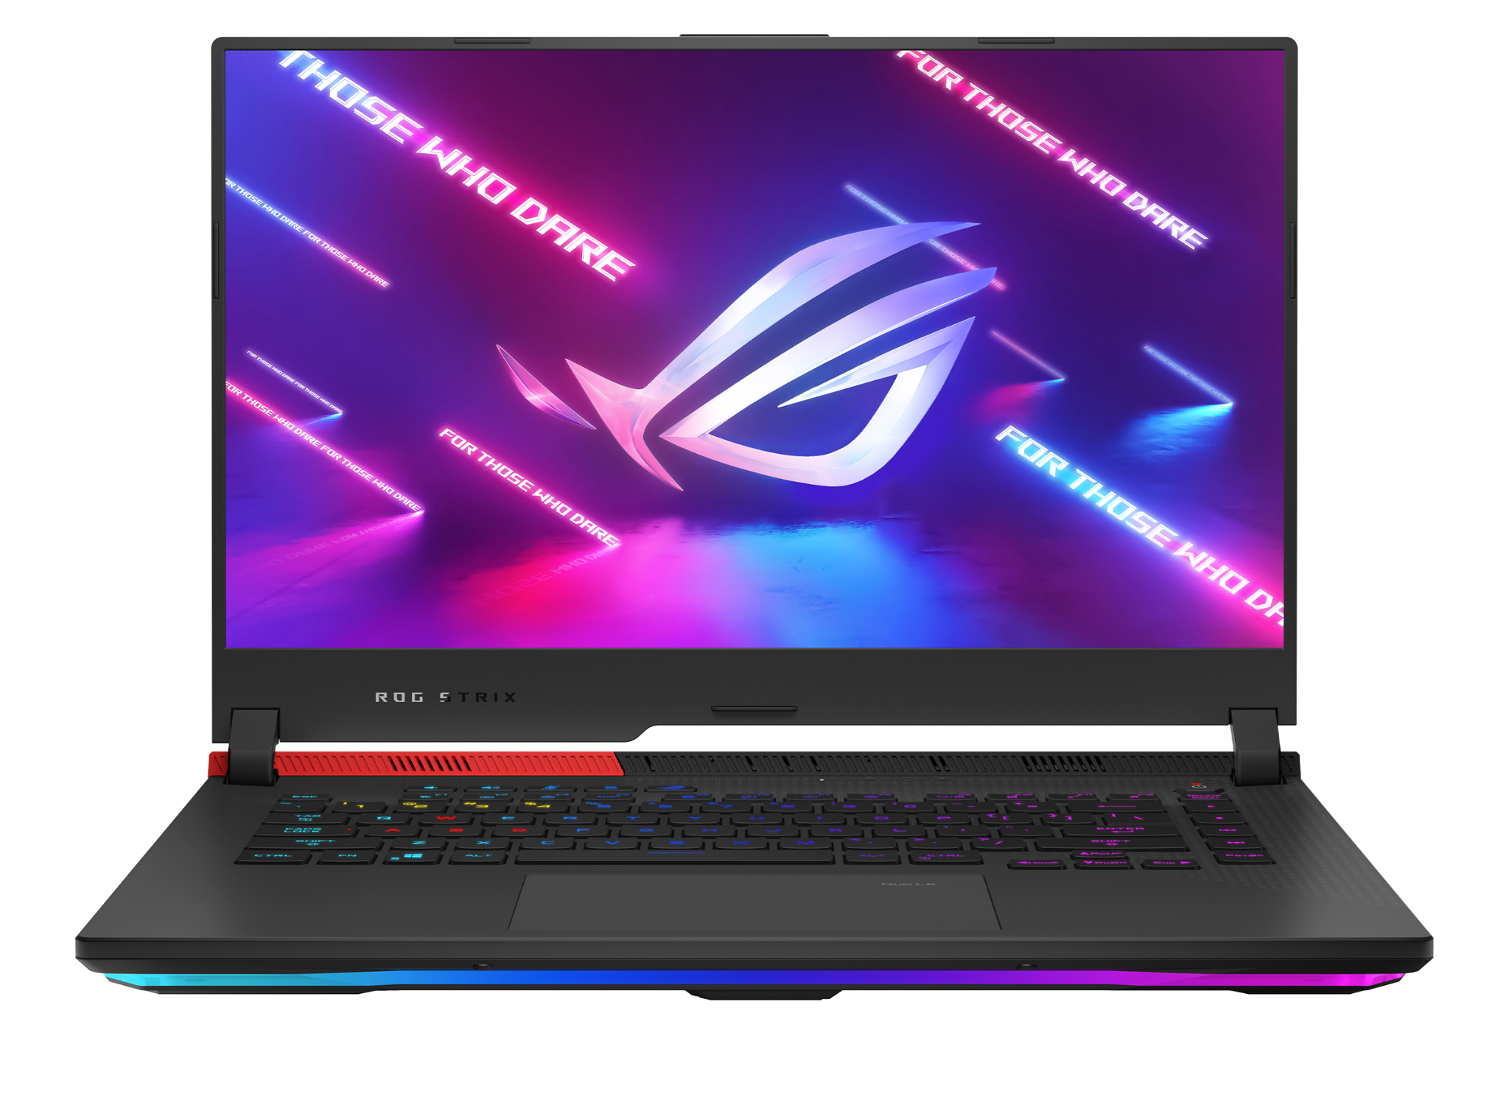
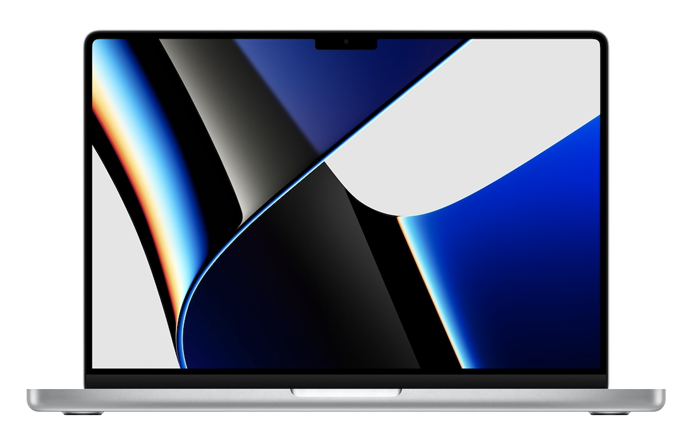
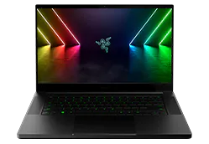
Chipset Comparison
Melvin
AMD | Apple | Intel
AMD Ryzen 7 5800H Number of Cores - 8 cores Clock Speed - 3.201 GHz L1: 512 KB, L2: 4.0 MB, L3: 16.0 MB | M1 Pro Number of Cores - 8 performance, 2 efficiency Clock Speed - 2.06 GHz L1: 192KB, L2: 12MB, L3: 128MB | 12th Gen Intel i9-12900H Number of Cores - 6 performance, 8 efficiency Clock Speed - 2.92 GHz L1: 544 KB, L2: 512 KB, L3: 24 MB

Slide 7
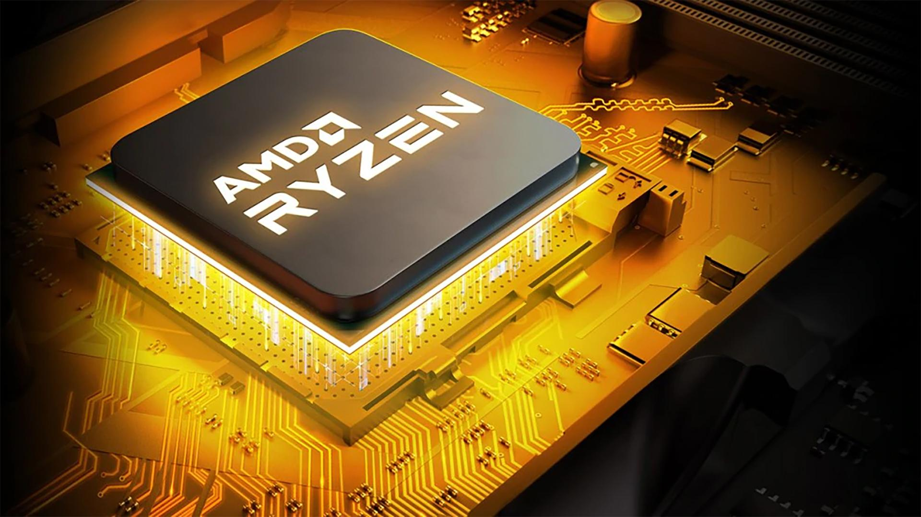
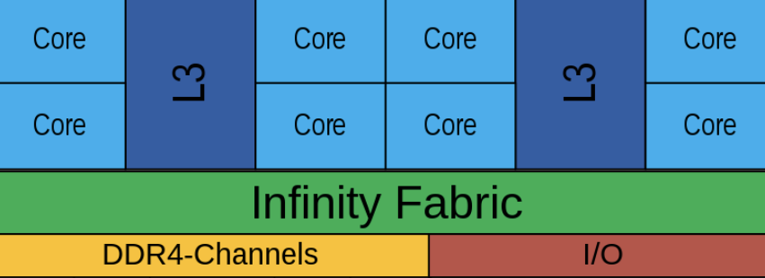
AMD Architecture
Melvin
x86 CISC, Von Neumann architecture
Dedicated L1 and L2 Cache per processing core
L3 Cache amongst cores
7nm process node

Slide 8
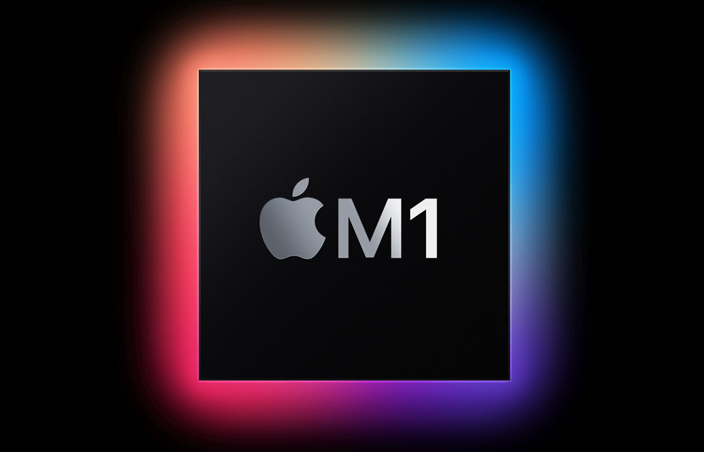
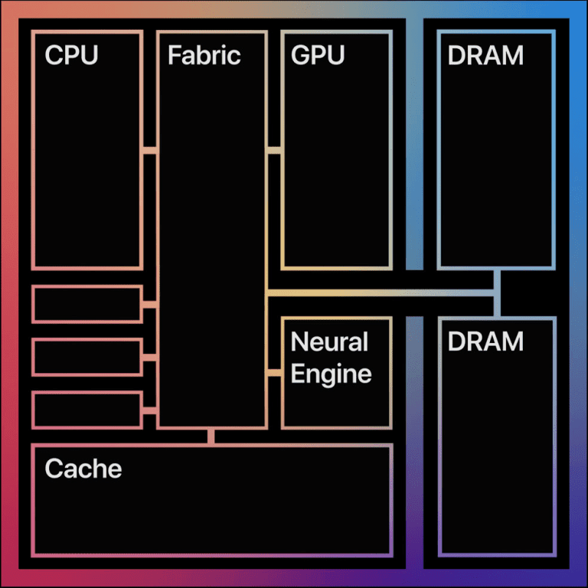
Apple Architecture
Melvin
RISC, Von Neumann architecture
Dedicated L1 per processing core
Shared L2 & L3 Cache amongst cores
ARM Based
5nm Process node

Slide 9
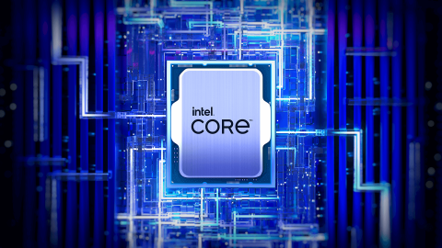
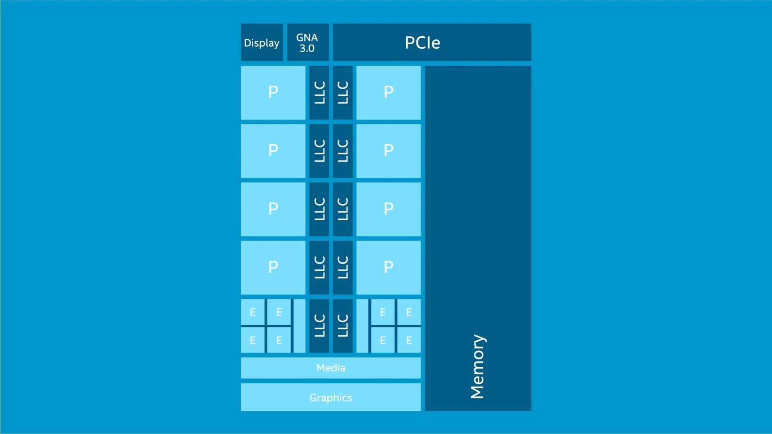
Intel Architecture
Melvin
x86 CISC, Von Neumann architecture
Dedicated L1 Cache per processor cores
Shared L2 & L3 Cache amongst cores
10nm Process node

Slide 10
System Analysis
Jeremy
AMD System | Apple System | Intel System
ASUS 2021 ROG Strix SCAR 15 RTX 3080 32GB of DDR4 Windows 11 OS | Macbook Pro, 2021 Integrated Graphics 16 GB Unified Memory (close to DDR5) Mac OS 13.4 | Razer Blade 15 2022 RTX 3070Ti 16 GB of DDR5 (runs faster than DDR4) Windows 11 OS
Notes:
Booting Conditions: All systems booted in safe mode (eliminates non essential applications and drivers)
Cooling Impact: Difference in system cooling may effect on CPU performance (cooler equals better)
Gaming vs Productivity: Difference in system designed for gaming vs system designed for efficiency
Core Utilization: Intel and AMD designed for gaming (will use all cores) - Apple designed for optimal performance (tends to use only efficiency cores)
Ideal Scenario : In an ideal case CPU would offload image processing to GPU (Graphics Processing Unit)

Slide 11
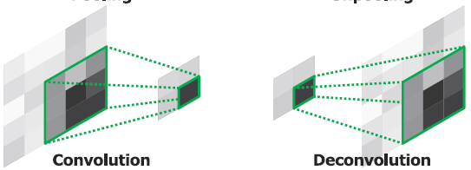
Convolution and Deconvolution
Akira
Code utilized: restoredImage = deconvlucy(convImage, psf, run)
CONVOLUTION
DECONVOLUTION
Adds up info across various pixels to one pixel
Uses one pixel and spreads it to various pixels

Slide 12
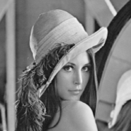
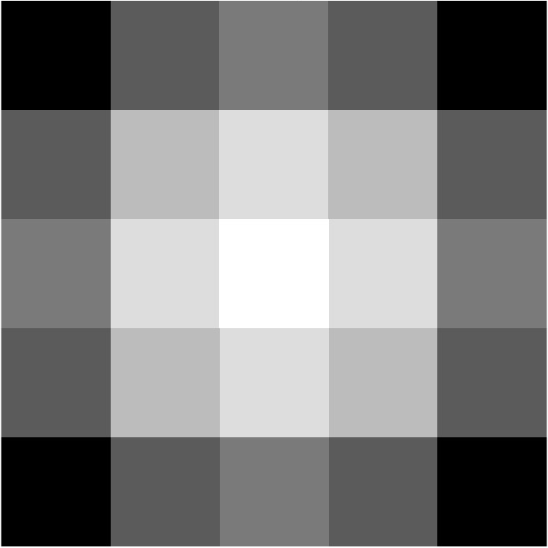
Data Set & Parameters
Akira
Same Code Utilized
OS in safe mode
Same MATLAB Versions
Input Image
Gaussian PSF

Slide 13
03
RESULTS

Slide 14



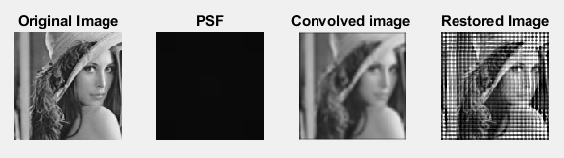
AMD Results
Jeremy
Num Iterations (s) | 1 | 10 | 50 | 100
Total Run time (s) | 0.012946 | 0.21505 | 3.499 | 13.5204
Avg Run time (s) | 0.012946 | 0.021505 | 0.069979 | 0.1352
CPU Usage (%) | 8.9 | 11.7 | 61.3 | 61.3
1
50
10
100

Slide 15
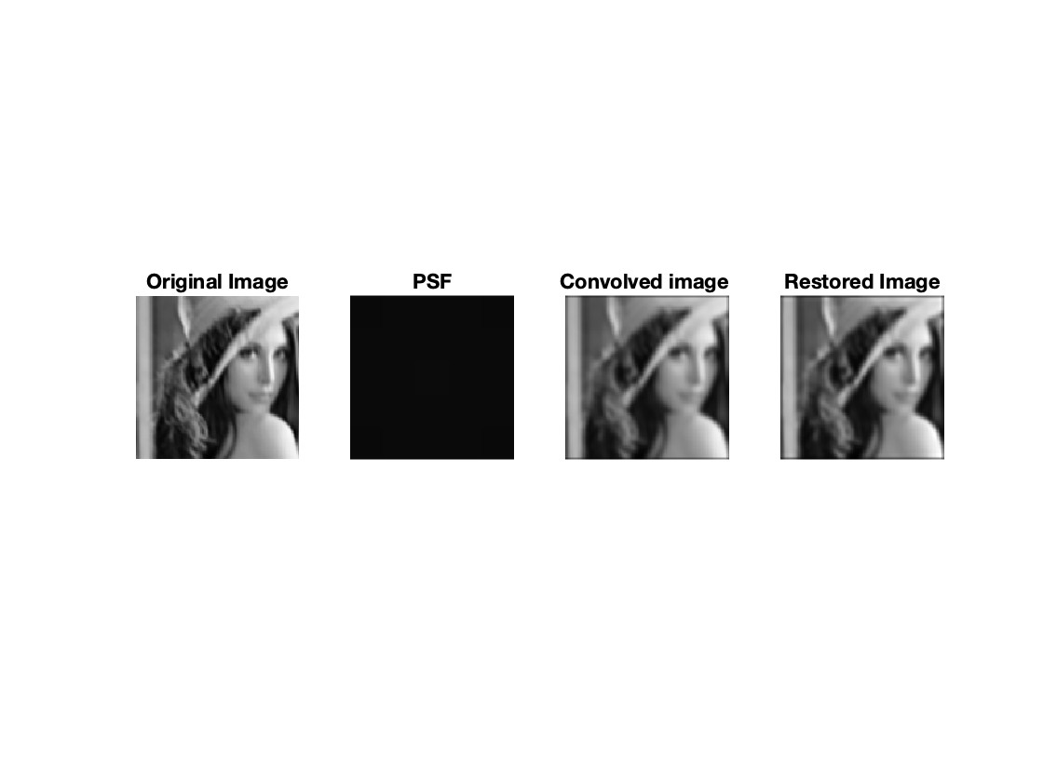
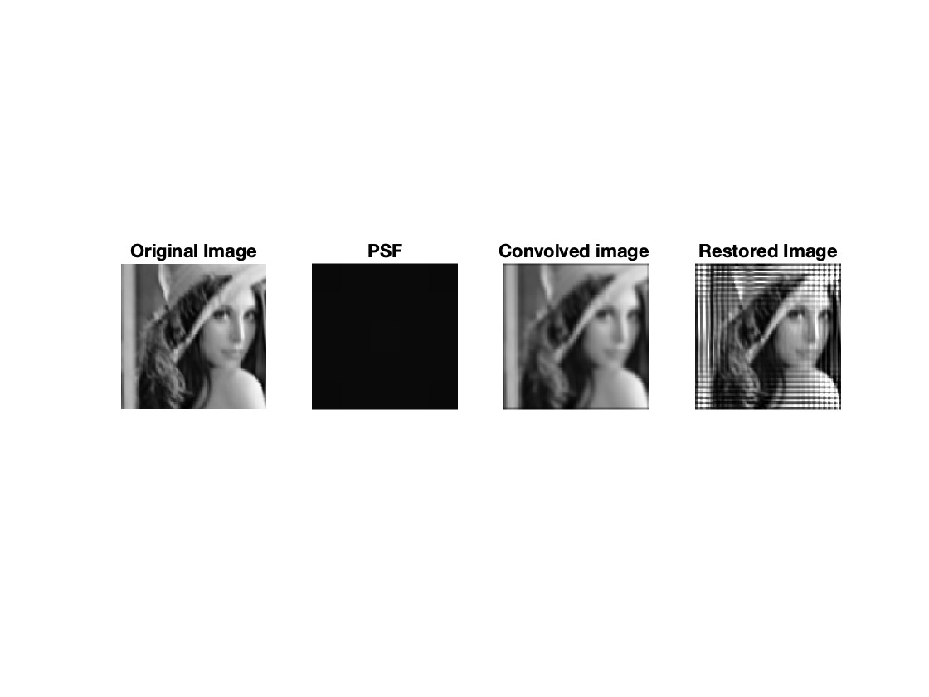


Apple Results
Melvin
Num Iterations | 1 | 10 | 50 | 100
Total Run time (s) | 0.0082582 | 0.33604 | 7.2267 | 28.206
Avg Run time (s) | 0.0082582 | 0.033604 | 0.14453 | 0.28206
CPU Usage (%) | 14.5 | 55 | 98.6 | 99.98
1
50
10
100

Slide 16
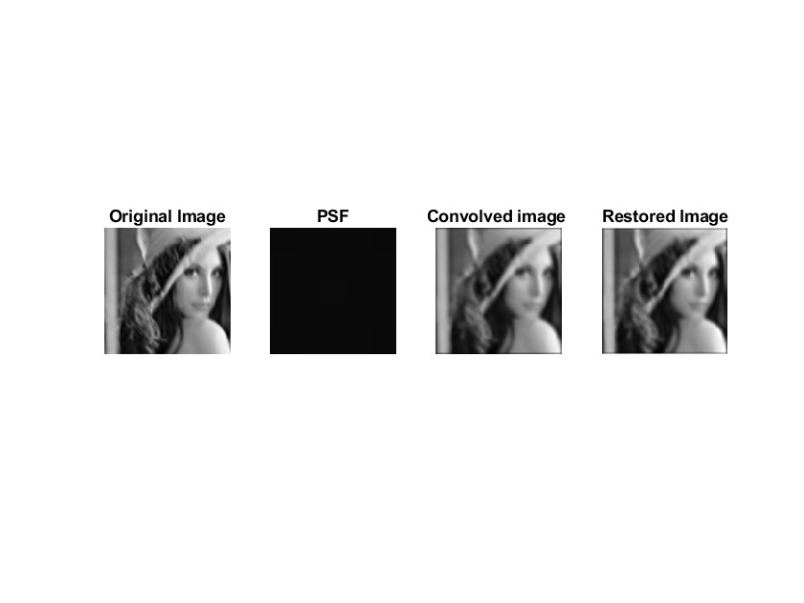
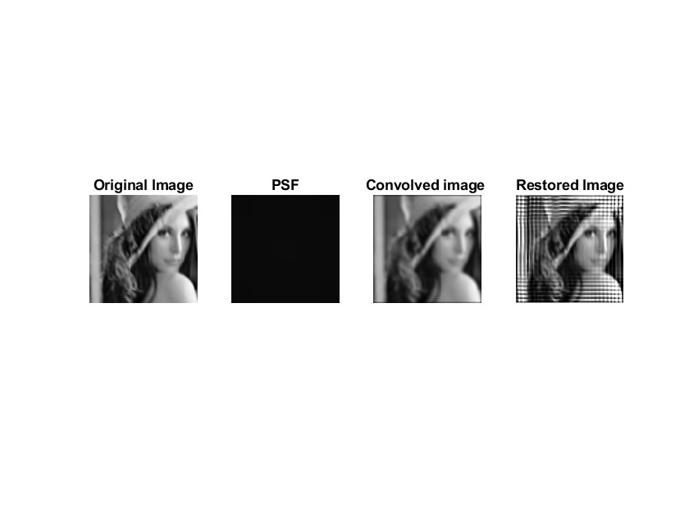


Intel Results
Jeremy
Num Iterations (s) | 1 | 10 | 50 | 100
Total Run time (s) | 0.0055604 | 0.18573 | 3.6528 | 14.0725
Avg Run time (s) | 0.0055604 | 0.018573 | 0.073057 | 0.14073
CPU Usage (%) | 4 | 14 | 37 | 36
1
50
10
100

Slide 17
04
COMPARISON & ANALYSIS

Slide 18
Iteration Run Time Comparison
Akira
# of Iterations | Time AMD (s) | Time Apple (s) | Time Intel (s)
1 | 0.012946 | 0.0082582 | 0.0055604
10 | 0.021505 | 0.033604 | 0.018573
50 | 0.069979 | 0.14453 | 0.073057
100 | 0.1352 | 0.28206 | 0.14073

Slide 19
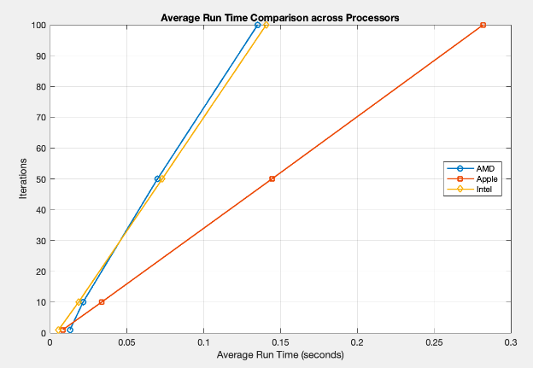
Average Run Time Across Iterations
Akira
Notes:
AMD does the best overall for speed
Initially, Intel does the best for speed
Apple is significantly worse than AMD and Intel for speed
AMD least difference across all number of iterations for avg run time
Apple has biggest difference between number of iterations

Slide 20
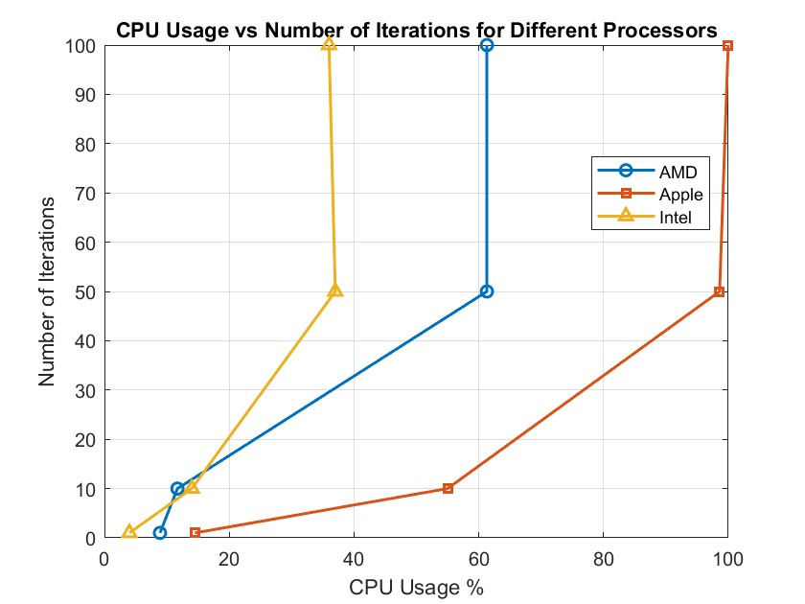
CPU Usage % Comparison
Akira
Notes:
1 10 50 100
At highest and lowest iteration count, intel uses the least CPU % and Apple uses the most CPU %
AMD vs Apple
AMD uses less CPU overall but it's more apparent with higher iterations
AMD vs Intel
AMD uses more CPU overall, but is most significant at higher iterations
Appel vs Intel
Apple uses significantly more CPU than Intel

Slide 21
05
CONCLUSION

Slide 22
Inferences and Key metrics
Jeremy
AMD
Apple
Intel
CPU usage threshold ~61.3%
Designed for gaming and utilizes all cores
Uses more power in performance
Thus more cooling, shorter battery life, bigger footprint
Leverages raw power (brute force)
Core usage limited to 2/10 cores at 100%
OS forces system to prioritize efficiency over speed
Uses less power
Thus less cooling, longer battery, and smaller footprint
Faster communication to integrated graphics and memory
Better for efficiency and longevity
CPU usage threshold around 36-37%
Made for gaming and performance tasks
Uses more power
Thus more cooling, shorter battery life, bigger footprint
DDR5 compatible for faster CPU → Memory communication
Better middle ground processor

Slide 23
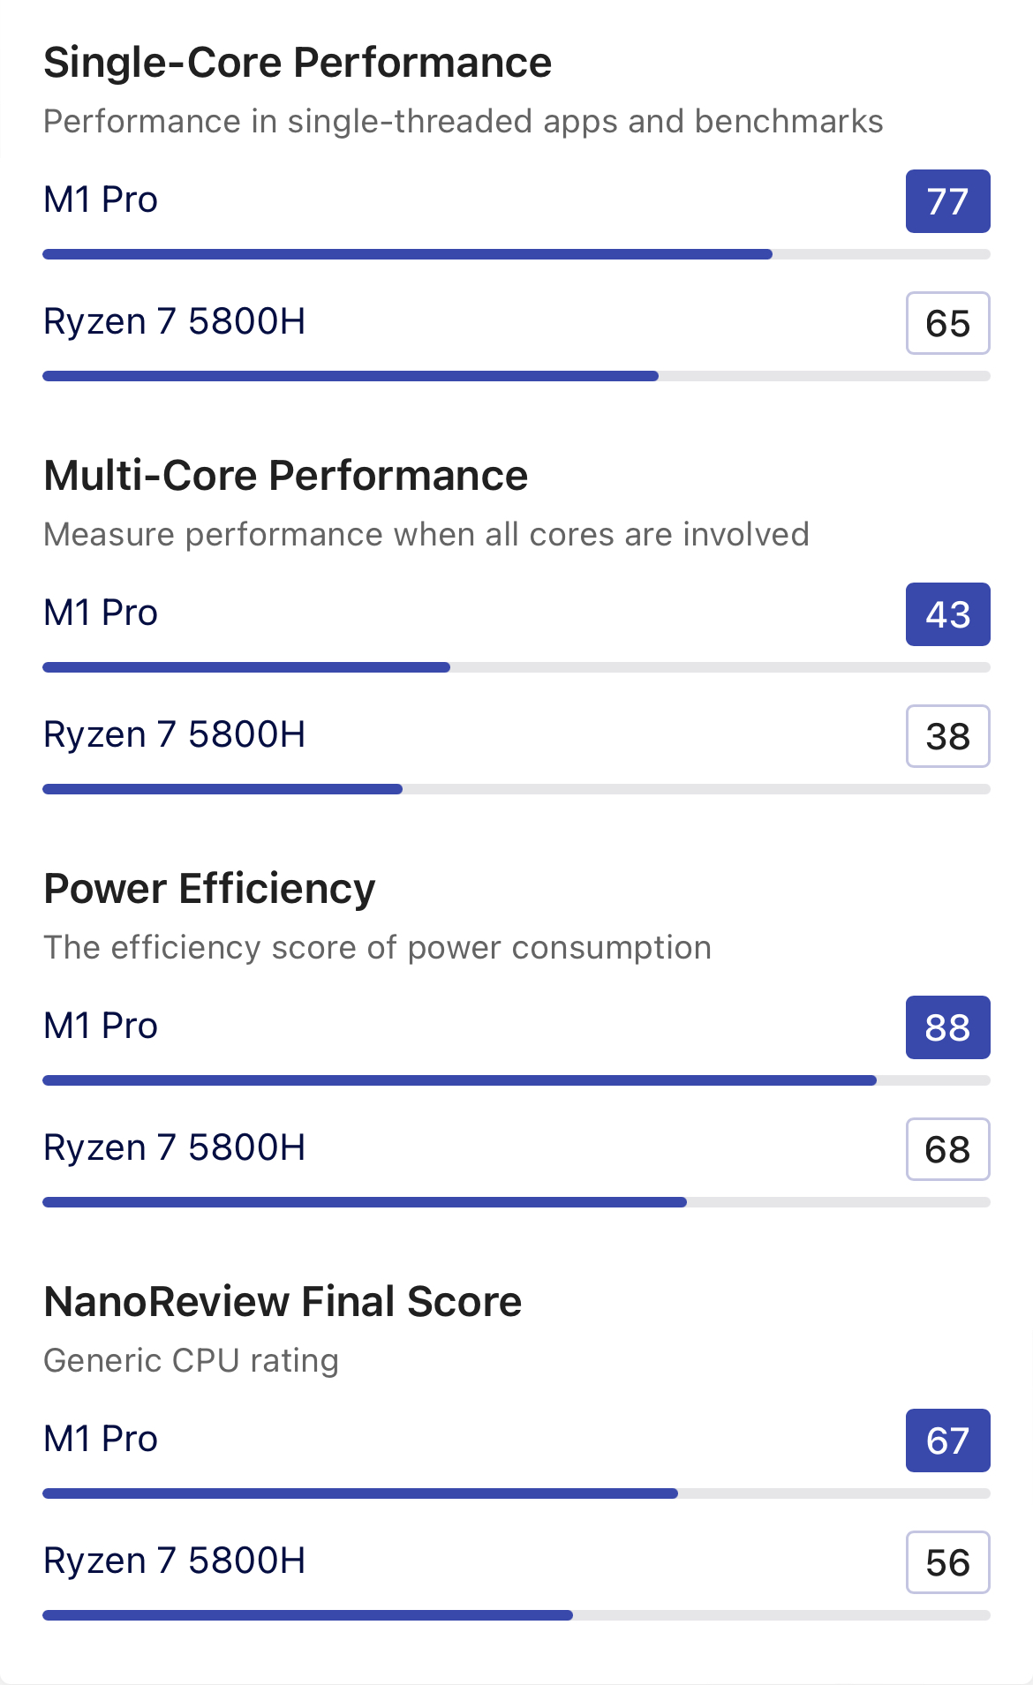
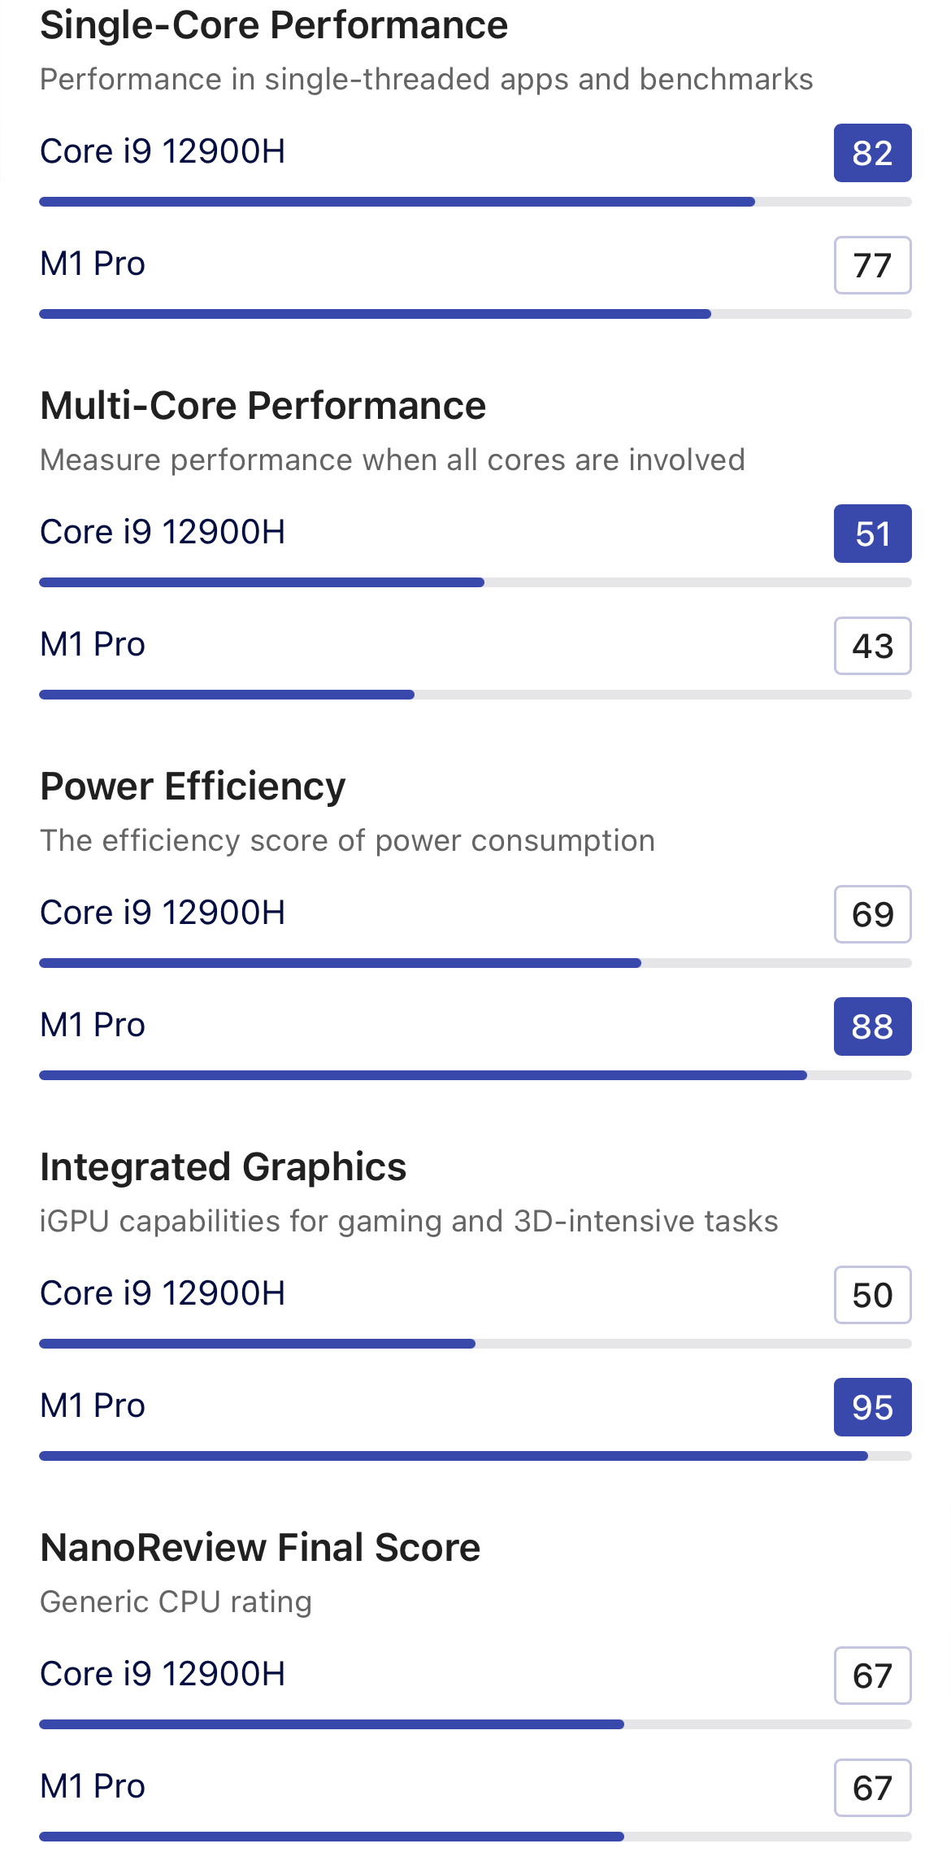
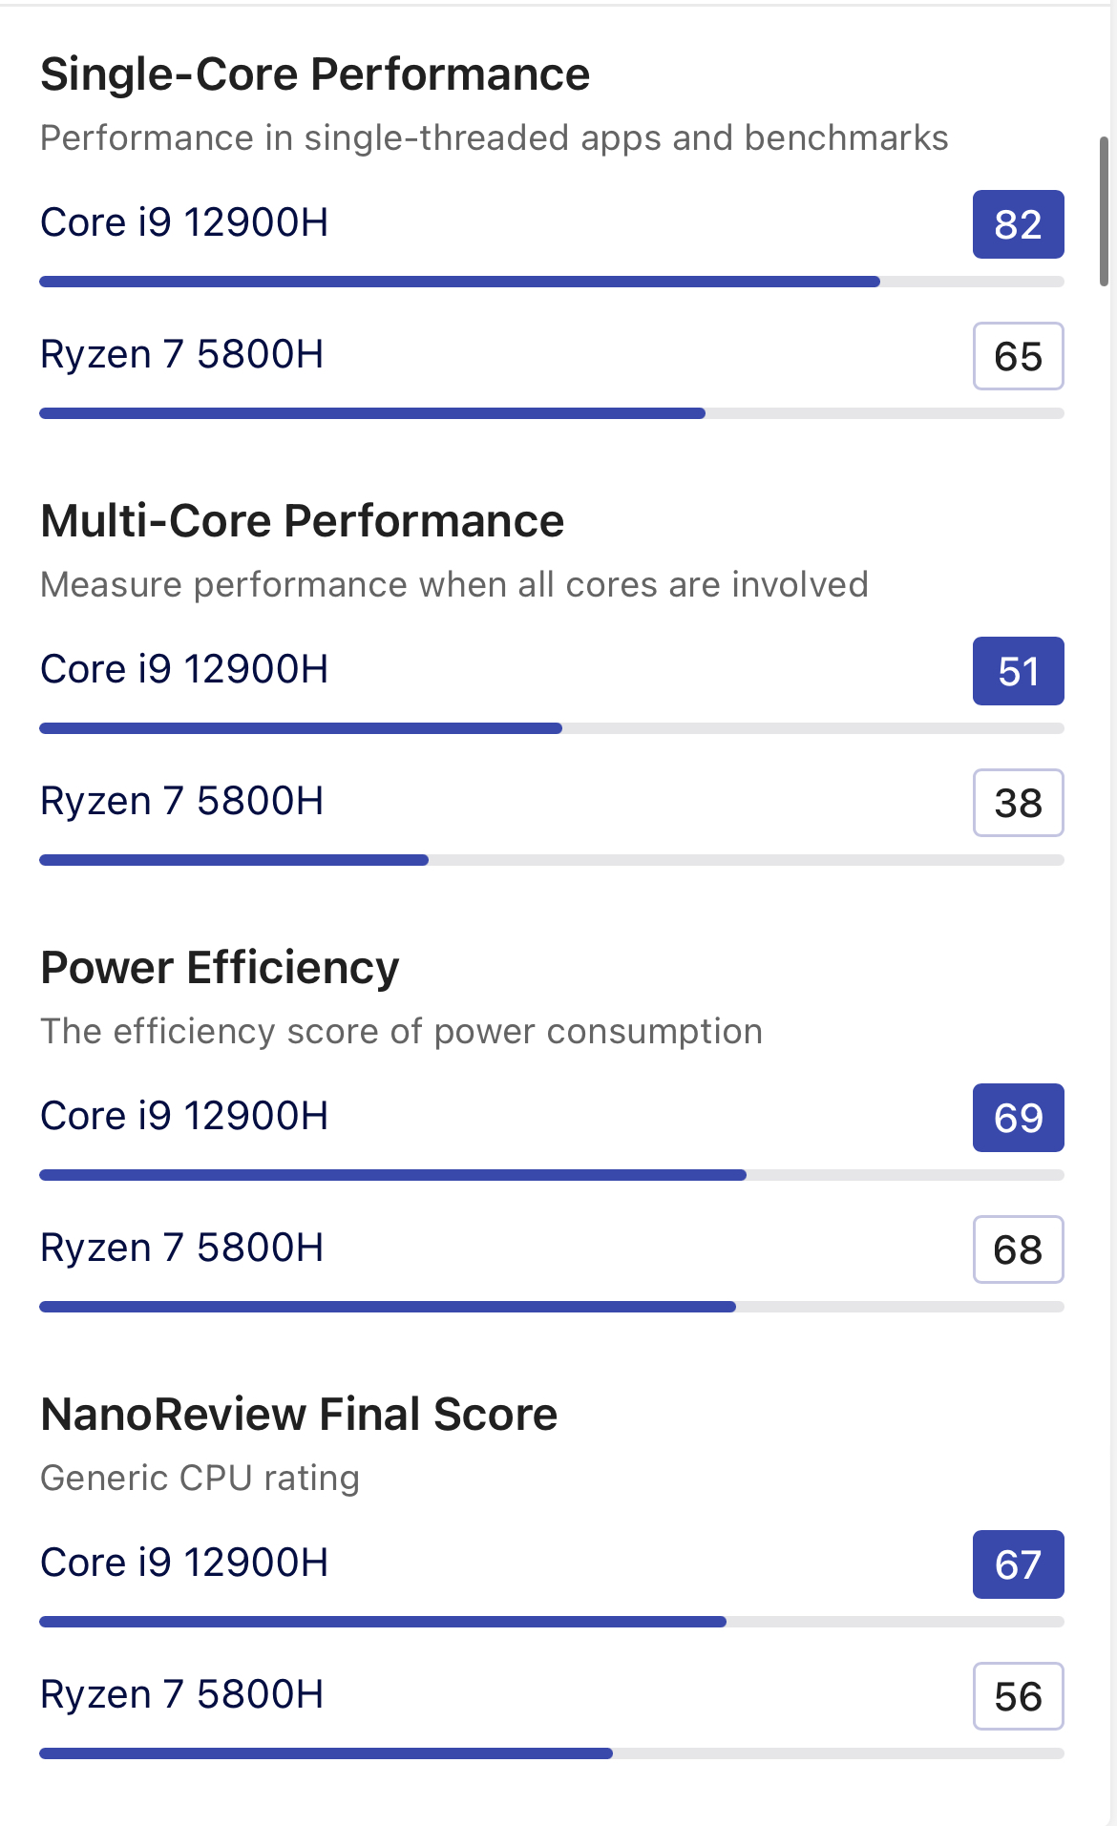
3rd Party Benchmarks
Jeremy
Apple vs AMD
Intel vs Apple
Intel vs AMD

Slide 24
Potential Errors
Jeremy
Varying environments
- Different room temperatures will affect cooling and thus affect performance
- Different cooling systems (ASUS, Razer, Apple)
Difference in memory
- DDR4 versus DDR5 in AMD and Intel systems
- DDR5 has more bandwidth and better data transfer while also operating at lower power (lower power → less heat → better performance)
Difference in OS
- Apple M1 chip used only 2 cores (efficiency cores) while AMD and Intel utilizes all cores
- CPU performance still spikes
- Different GPUs in each system
Future Considerations
- Use Cinebench
Notes:
AMD
Program Total Run Time(sec): 0.012946, 0.21505, 3.499, 13.5204 (1, 10, 50, 100 iterations)
Iteration Avg Run Time(sec): 0.012946, 0.021505, 0.069979, 0.1352 (1, 10, 50, 100 iterations)
Percent CPU Usage Peak(%): 8.9, 11.7, 61.3, 61.3 (1, 10, 50, 100 iterations)
Apple
Program Total Run Time(sec): 0.0082582, 0.33604, 7.2267, 28.206 (1, 10, 50, 100 iterations)
Iteration Avg Run Time(sec): 0.0082582, 0.033604, 0.14453, 0.28206 (1, 10, 50, 100 iterations)
Percent CPU Usage Peak(%): 14.5, 55, 98.6, 99.98 (1, 10, 50, 100 iterations)
Intel
Program Total Run Time(sec): 0.0055604, 0.18573, 3.6528, 14.0725 (1, 10, 50, 100 iterations)
Iteration Avg Run Time(sec): 0.0055604, 0.018573, 0.073057, 0.14073 (1, 10, 50, 100 iterations)
Percent CPU Usage Peak(%): 4, 14, 37, 36 (1, 10, 50, 100 iterations)

Slide 25
THANKS!
Please give us A 🙏

